Slide 1

School of Computer Science and Engineering
Department of Computer Science and Engineering
Resume Screening and Classification using Machine Learning and BERT
Supervised By:
Dr. Tarun Jain
Submitted by: Yash Tyagi
Registration Number: 2427030042

Slide 2

PROBLEM STATEMENT
The Challenge of Automated Resume Screening
In today's competitive job market, human resource departments are inundated with vast numbers of resumes. Manual screening is time-consuming, prone to human bias, and inefficient, creating a critical need for automated solutions.
Automated resume classification streamlines the initial screening process, allowing recruiters to quickly identify qualified candidates for specific job roles based on predefined categories. This research addresses the demand for effective and robust classification systems.

Slide 3

RESEARCH GOALS
Reproducing and Advancing Resume Classification
1
2
3
Reproduce Existing Research
Comparative Analysis
Performance Evaluation
Conduct a thorough comparison between classical machine learning techniques and transformer-based deep learning (BERT) for resume classification.
Assess the strengths and weaknesses of each approach using a comprehensive suite of evaluation metrics.
Systematically replicate key methodologies from a prominent resume classification paper to validate findings and establish a baseline.

Slide 4
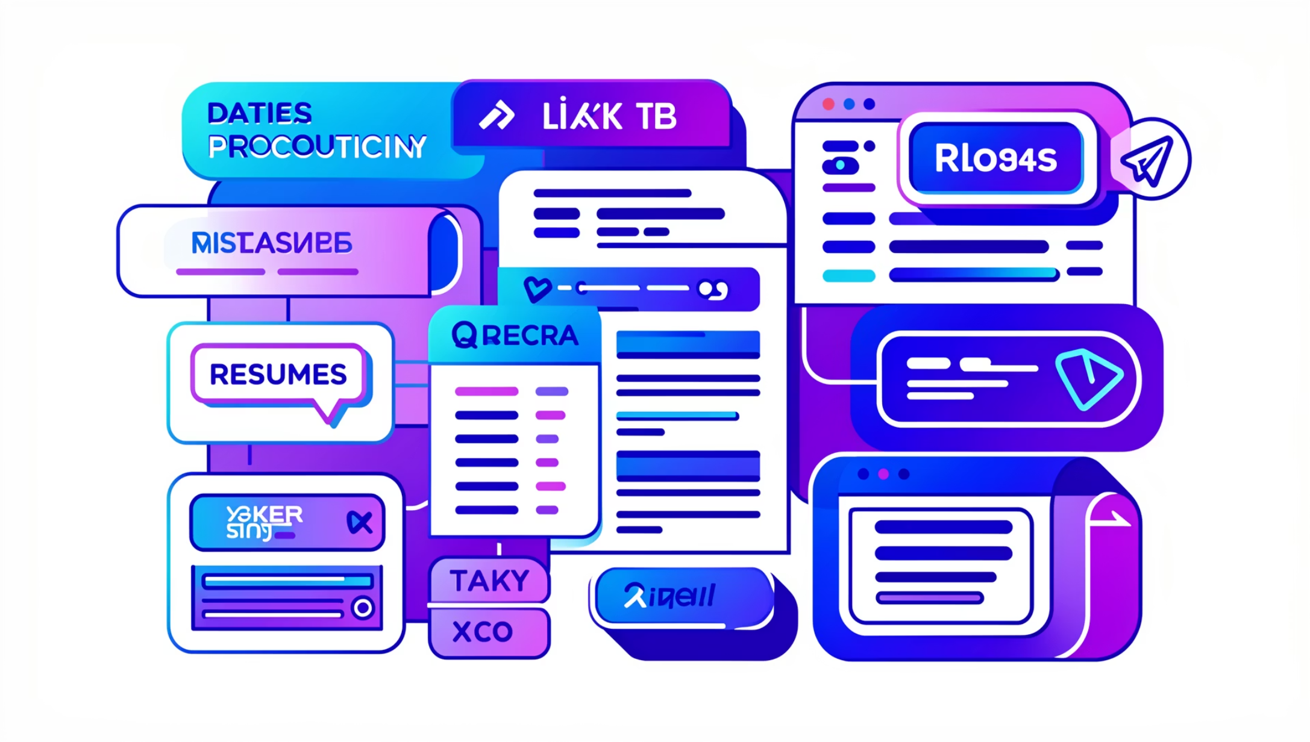
DATASET
ResumeAtlas: A Foundation for Classification
Dataset Name: ResumeAtlas
Total Samples: 13,389 unique resumes
Number of Classes: 43 distinct job categories
Data Source: Publicly available research dataset
Preprocessing: Standardized text cleaning, tokenization, and normalization techniques applied to enhance model performance.

Slide 5




EXPERIMENTAL DESIGN
Stratified Data Splitting for Robust Evaluation
Training
Validation
Testing
To ensure unbiased model evaluation and prevent data leakage, the ResumeAtlas dataset was strategically split into three subsets, maintaining class distribution through stratification.
Training Set: 70% (9,372 samples) - Used for model learning and parameter optimization.
Validation Set: 10% (1,339 samples) - Utilized for hyperparameter tuning and early stopping to prevent overfitting.
Testing Set: 20% (2,678 samples) - Reserved for final, unseen performance evaluation of the trained models.

Slide 6

CLASSICAL ML
Classical Machine Learning Pipeline Architecture
Text Preprocessing
Model Training
Feature Extraction
The classical machine learning pipeline involves sequential stages from raw text to classified output. This structured approach allows for clear feature engineering and model interpretability.
Each stage plays a critical role in transforming unstructured text data into a format suitable for traditional algorithms, culminating in a robust evaluation of classification performance.

Slide 7


CLASSICAL ML MODELS
Feature Engineering and Model Selection
Bag-of-Words (BoW) + Linear SVM
TF-IDF + Linear SVM
GloVe Embeddings + Logistic Regression
Advanced term weighting scheme (Term Frequency-Inverse Document Frequency) to capture word importance, paired with SVM.
Simple yet effective frequency-based feature representation, combined with a powerful linear classifier.
Pre-trained global vector word embeddings averaged to represent documents, followed by a probabilistic linear model.
These models represent a range of classical approaches, from statistical frequency-based methods to pre-trained semantic representations, offering diverse perspectives on resume text analysis.

Slide 8

TRANSFORMER MODEL
BERT: Fine-Tuning for Contextual Understanding
BERT (Bidirectional Encoder Representations from Transformers) leverages a pre-trained deep neural network to understand the contextual relationships between words in a sequence. For resume classification, bert-base-uncased was fine-tuned specifically for sequence classification.
Fine-tuning: 7 training epochs for optimal learning.
Learning Rate Scheduler: Cosine decay with warmup steps for stable convergence.
Optimization: FP16 mixed precision training to accelerate computation and reduce memory footprint.
Hardware: Utilized RTX 4060 GPU for efficient training.

Slide 9
EVALUATION
Comprehensive Performance Metrics
1
Accuracy
Overall correctness of the model's predictions: (True Positives + True Negatives) / Total Samples.
2
Precision
The proportion of true positive predictions among all positive predictions: True Positives / (True Positives + False Positives).
3
Recall
The proportion of true positive predictions among all actual positive samples: True Positives / (True Positives + False Negatives).
4
Weighted F1-score
The harmonic mean of precision and recall, weighted by the number of true instances for each label, accounting for class imbalance.
5
Macro F1-score
The unweighted average of F1-scores for each class, giving equal importance to all classes regardless of their size.
6
Confusion Matrix
A table that visualizes the performance of a classification model, showing actual vs. predicted classes.

Slide 10
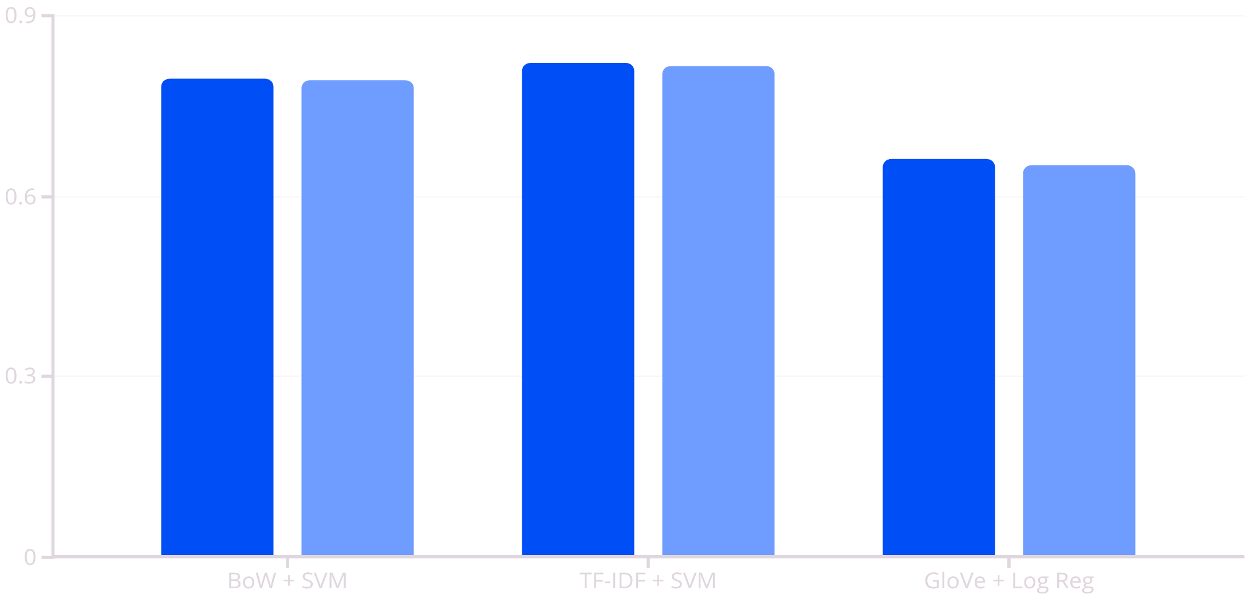
RESULTS (CLASSICAL ML)
Classical Machine Learning Test Set Performance
The TF-IDF + Linear SVM model demonstrated the strongest performance among the classical machine learning approaches, achieving the highest accuracy and weighted F1-score on the unseen test data. This indicates the effectiveness of TF-IDF in capturing discriminative features for resume text.
Accuracy
Weighted F1

Slide 11

Resume Classification: Transformer Models for Talent Acquisition
This research explores the efficacy of classical machine learning and transformer-based deep learning for resume classification, utilizing the extensive ResumeAtlas dataset. Our objective is to enhance automated talent acquisition processes through robust classification.

Slide 12
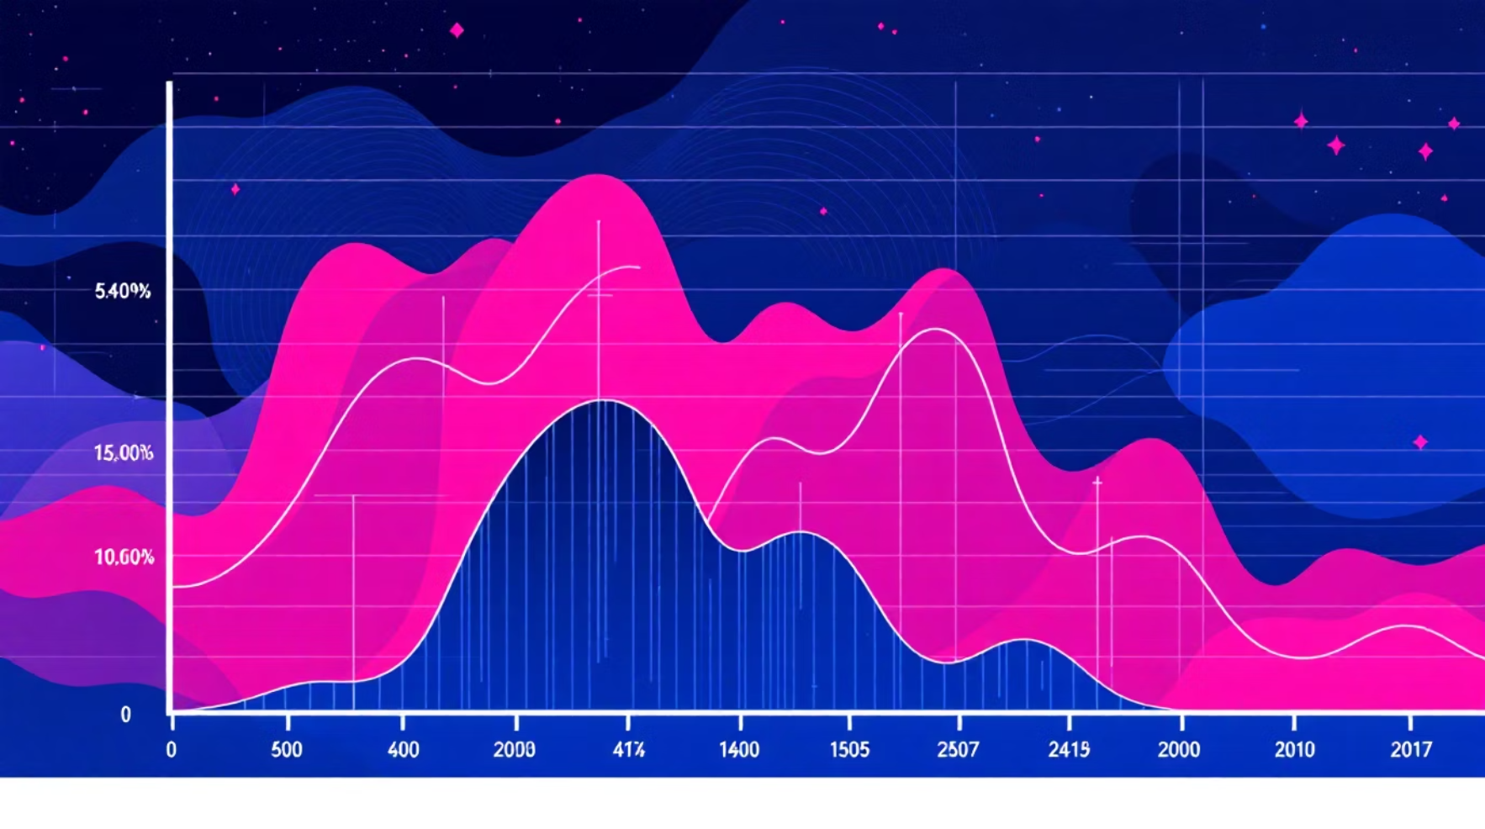
BERT Model Training and Performance
Robust Performance on ResumeAtlas
Our fine-tuned BERT model demonstrates strong performance in multi-class resume classification. Optimized training protocols ensured efficient resource utilization while achieving high accuracy metrics.
Transformer Model: BERT (bert-base-uncased)
Fine-tuning: Multi-class classification
Training Epochs: 7
Learning Rate: Cosine scheduler
Precision: Mixed FP16 training
Hardware: GPU (RTX 4060)
Training Accuracy
Validation Accuracy
96.9%
88.5%
Test Accuracy
Test Weighted F1
89.43%
89.31%

Slide 13


Comparative Analysis
Benchmarking Against State-of-the-Art
Our BERT model's performance was rigorously compared against findings from the original research paper. While slightly lower, our results remain highly competitive, underscoring the model's effectiveness given hardware constraints.
The slight disparity is primarily attributed to differences in available hardware and extensive training resources, yet our model demonstrates strong generalization capabilities.
1
2
Our Model (BERT)
Original Research (BERT)
Test Accuracy: 89.43%
Test Accuracy: 91.2%

Slide 14


Experimental Insights & Challenges
Unpacking Key Findings and Limitations
Key Insights
Limitations Faced
Classical Models
Transformer Advantage
GPU memory constraints limited batch sizes and model complexity.
Protracted training times impacted iteration speed.
TF-IDF + Linear SVM emerged as the top classical model, but consistently showed significant overfitting, highlighting the need for more advanced techniques.
Transformer models excelled in capturing contextual semantics, leading to substantial improvements in classification performance over classical approaches.
Limited hyperparameter tuning due to resource scarcity.
Dataset's imbalanced class distribution posed a challenge.
Single GPU training environment restricted parallelization.

Slide 15

Future Directions
Advancing HR Automation with Enhanced AI
Our research provides a strong foundation for future advancements in automated resume classification. Addressing current limitations and exploring new methodologies will further refine and optimize HR tech solutions.
Advanced Architectures
1
Integrate state-of-the-art transformer models (RoBERTa, DeBERTa) for superior performance.
2
Ensemble Learning
Combine multiple models to boost predictive accuracy and robustness.
3
Robust Validation
Implement cross-validation to ensure model generalization across diverse datasets.
4
Real-World Deployment
Develop and deploy a scalable system for practical HR automation in recruitment.

Slide 16
System Pipeline for Resume Classification
01
02
Raw Resume Text Input
Text Preprocessing
Cleaning
Tokenization
03
04
Feature Extraction
Model Training
Bag of Words
TF-IDF
GloVe Embeddings
BERT Tokenization
Classical ML Models
Transformer Model
05
06
Model Evaluation
Performance Comparison
Accuracy
Precision
Recall
Weighted F1
Macro F1

Slide 17
Model Performance Comparison
BoW + Linear SVM
98.79
79.50
79.34
TF-IDF + Linear SVM
97.47
82.26
81.70
GloVe + Logistic Regression
67.81
66.13
65.07
BERT (bert-base-uncased)
96.90
89.43
89.31
BERT significantly outperforms classical models due to contextual understanding of text.

Slide 18
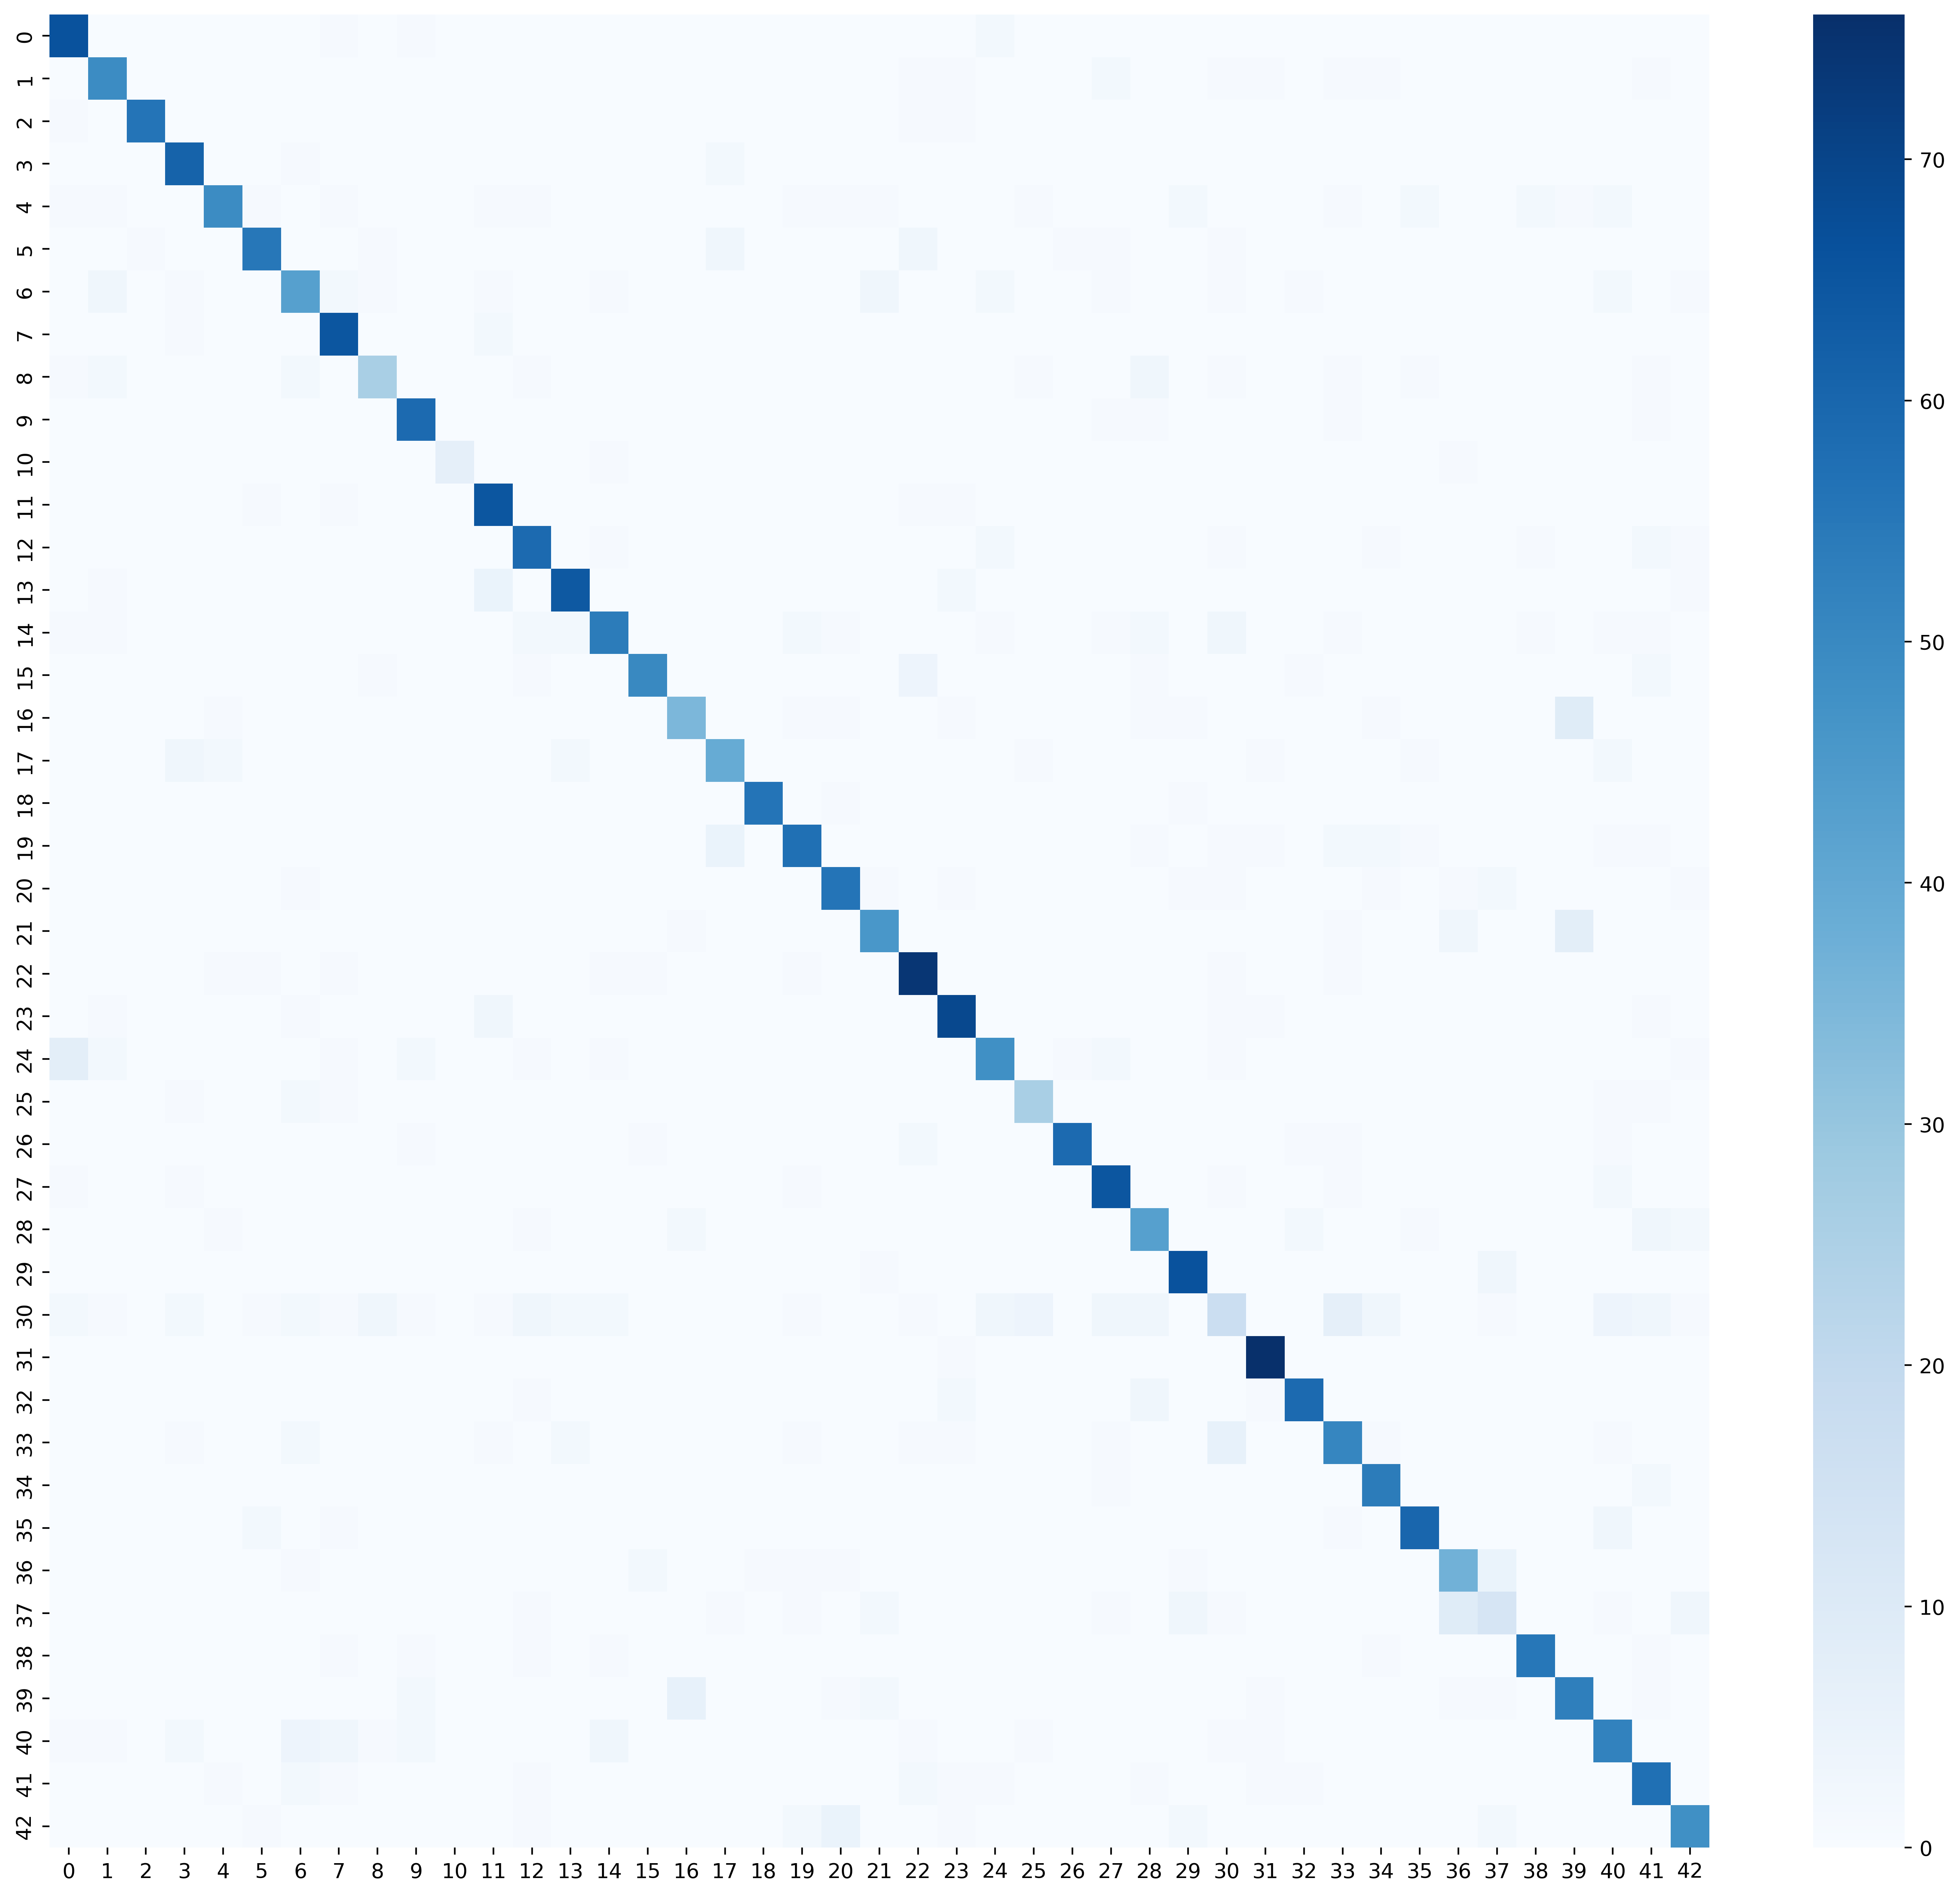
Confusion Matrix Analysis
Strong diagonal dominance indicates high classification accuracy.
Misclassifications occur between semantically similar job categories.
Model performs well across most classes.
Class imbalance may influence prediction distribution.

Slide 19
Our Contributions
Reproduced research paper methodology using ResumeAtlas dataset
Implemented full classical ML pipeline (BoW, TF-IDF, GloVe)
Fine-tuned BERT transformer model on local RTX 4060 GPU
Applied stratified data splitting (70/10/20)
Compared macro and weighted F1 evaluation metrics
Performed hyperparameter tuning for SVM models
Achieved near-paper performance with limited hardware
Built fully reproducible experimental pipeline

Slide 20
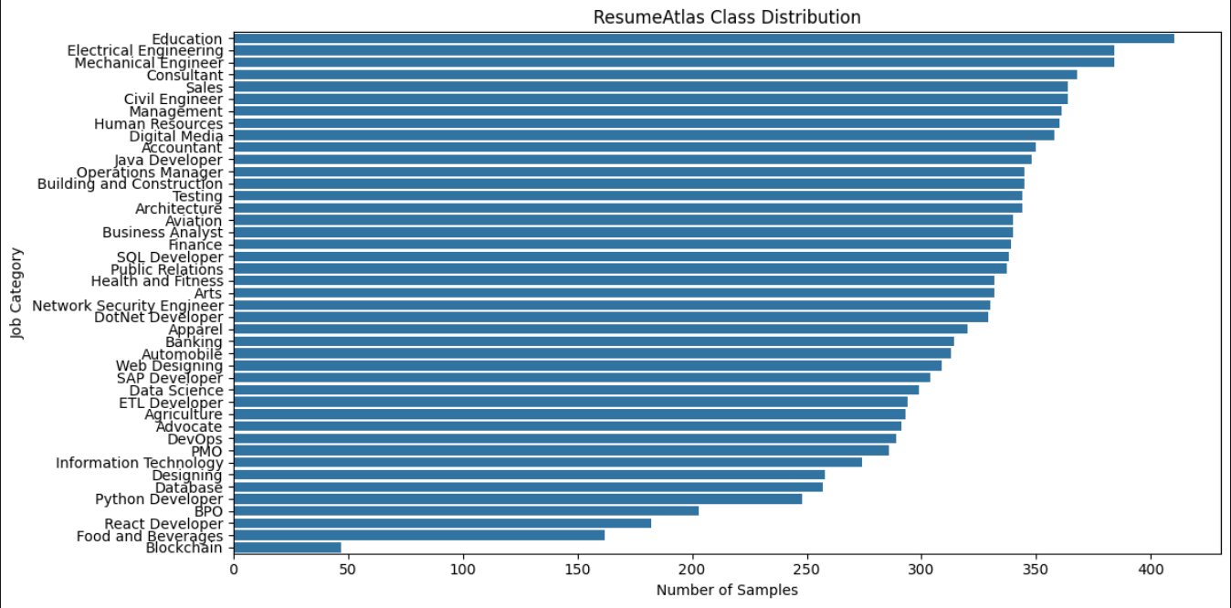

Dataset Class Distribution
The dataset contains 13,389 resumes across 43 unique job categories. The bar chart illustrates the frequency of these categories.
As depicted, the distribution is significantly imbalanced across various job classes, with some categories having a much higher representation than others.
To ensure a robust evaluation of our models, weighted evaluation metrics (such as weighted F1-score) were employed to account for this class imbalance.

Slide 21
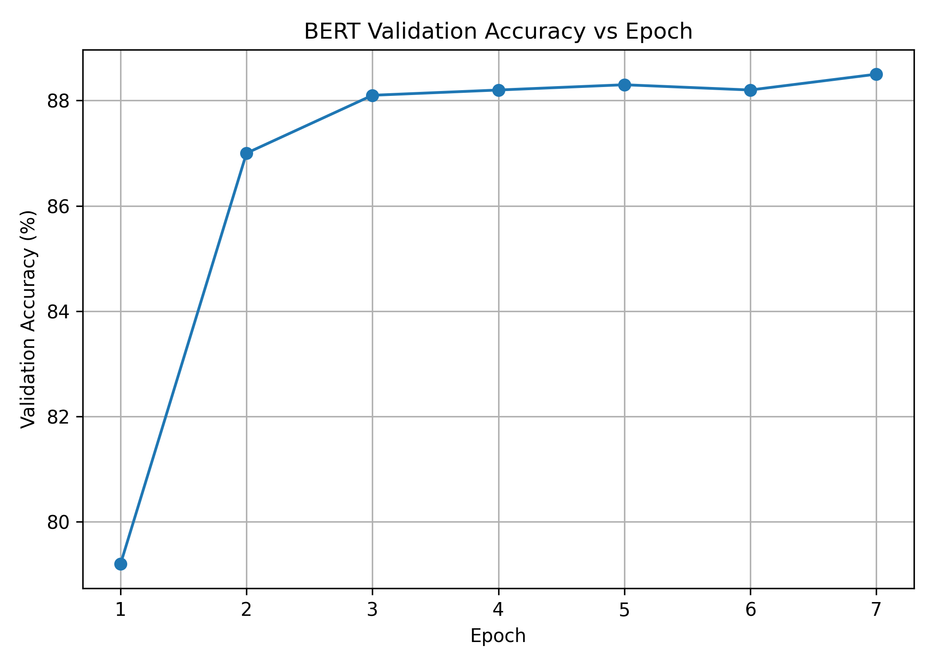
BERT Training Behaviour
Rapid accuracy increase in early epochs
Gradual convergence after mid training
Stable validation performance
Model converged successfully without severe overfitting.

Slide 22
BERT Training Configuration
Model:
bert-base-uncased
Epochs:
7
Learning Rate:
2e-5
Scheduler:
Cosine
Warmup Steps:
410
Batch Size:
8
Gradient Accumulation:
2
Effective Batch Size:
16
Mixed Precision:
FP16 enabled
GPU:
NVIDIA RTX 4060 (8GB)
Configuration chosen to replicate research paper training conditions within local hardware limits.

Slide 23
Key Findings
Transformer-based models significantly outperform classical ML approaches
TF-IDF remains strongest classical baseline
Contextual embeddings provide superior semantic understanding
High performance achievable with limited GPU resources
Automated resume screening is practically deployable

Slide 24
Limitations
Dataset limited to predefined job categories
Resume formatting variations affect feature extraction
Training performed on single GPU hardware
Some class imbalance present
No cross-domain generalization testing

Slide 25
Future Work
Evaluate advanced transformer models (RoBERTa, DeBERTa)
Perform cross-dataset generalization testing
Implement real-time resume screening system
Apply data augmentation techniques
Explore multilingual resume classification
Improve minority class prediction performance

Slide 26
Reproducibility and Resources
This project adheres to rigorous standards for reproducibility and transparency. The key resources and methodologies used are detailed below:
Dataset: ResumeAtlas (Kaggle)
Frameworks: PyTorch, Transformers, Scikit-learn
Hardware: RTX 4060 GPU
Code Repository: GitHub link
Experimentation Environment: Notebook-based experiments
Data Handling: Deterministic data splitting
All experiments are fully reproducible.

